Slide 1
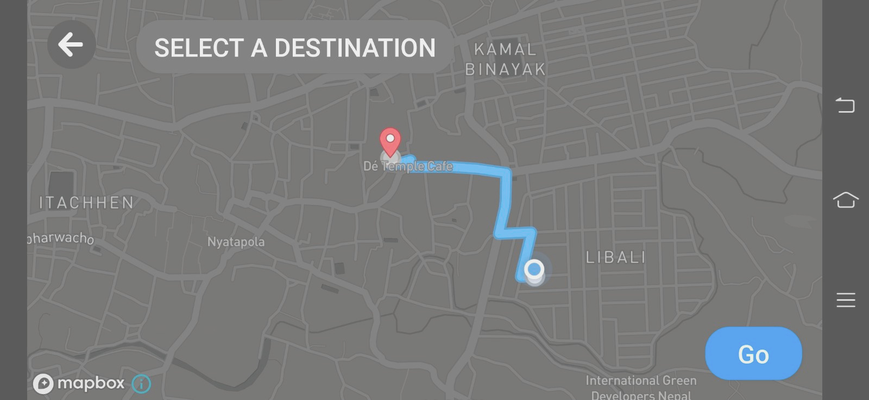
AR Tour Companion: Enhancing Travel Experiences with Voice Assistance
Abhishek Hyangol [KCE076BCT003]
Amit Shrestha [KCE076BCT004]
Anuj Gaida [KCE076BCT007]
Safal Raj Manandhar [KCE076BCT033]
KHWOPA COLLEGE OF ENGINEERING

Slide 2
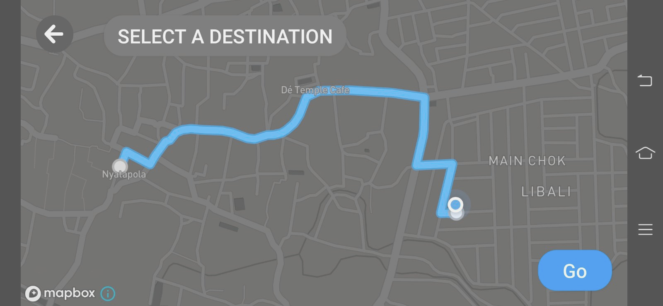
INTRODUCTION
Virtual tour guide mobile application using AR and NLP technologies
Provides detailed information about landmarks, enhancing cultural understanding
Navigation to local services (antique shops, restaurants, etc.) and monuments
Targeted location: Bhaktapur Durbar Square
1

Slide 3
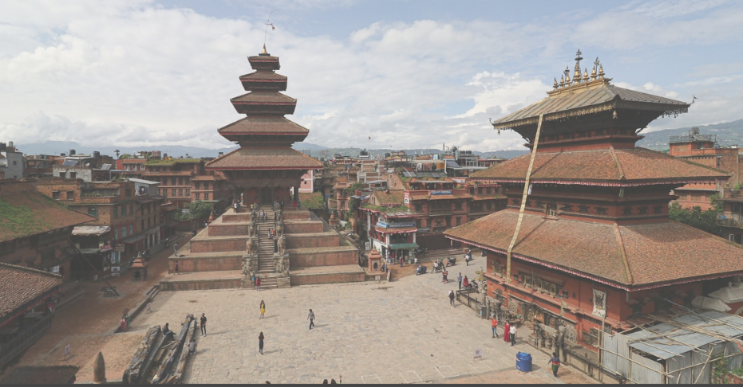

OBJECTIVE
To design a mobile application with an AR navigation component, Monument Recognition, and an audio Chatbot model that can function as a virtual tour guide.
2

Slide 4

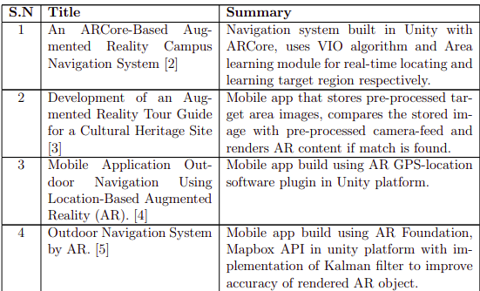
LITERATURE REVIEW
3

Slide 5
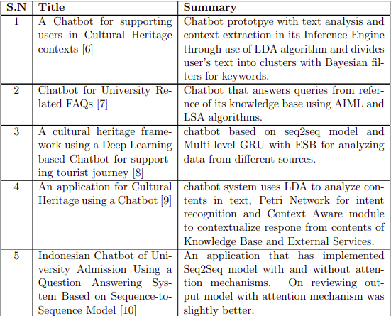
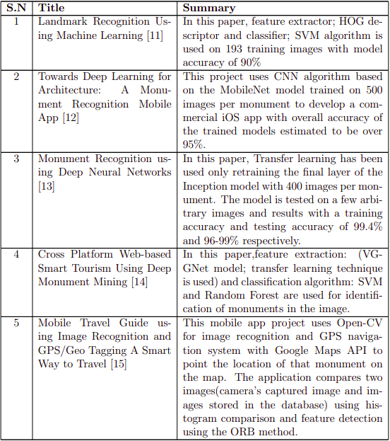
LITERATURE REVIEW
4

Slide 6
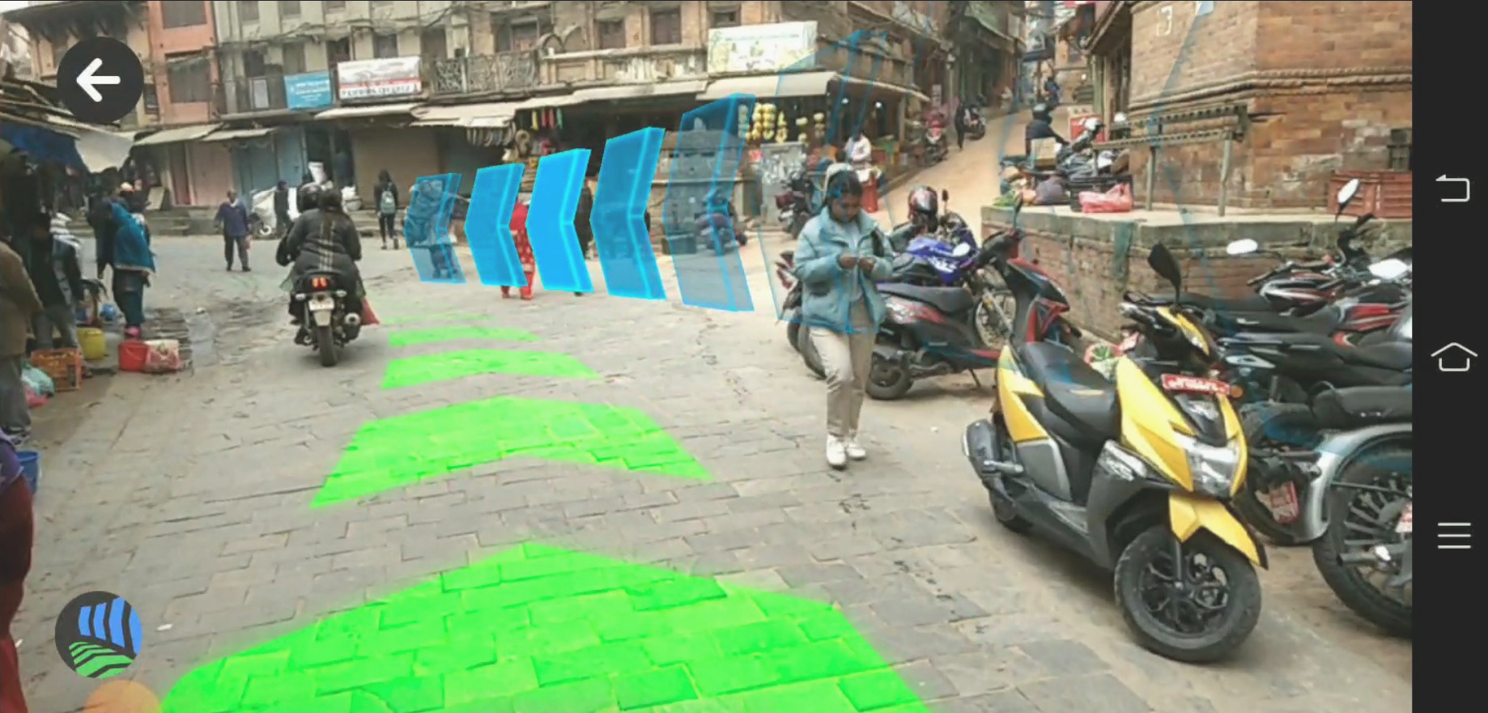
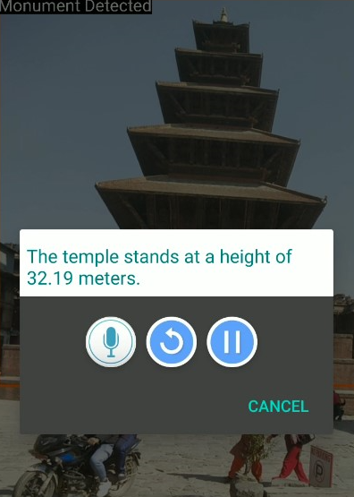
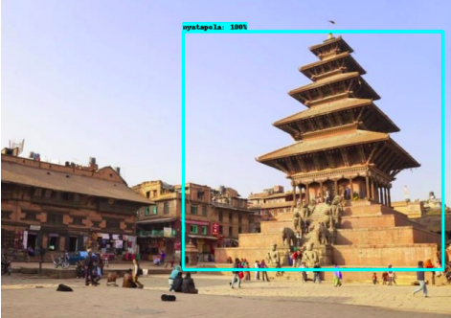
FUNCTIONAL REQUIREMENT
AR Navigation
Monument Detection
Monument Recognition
Interaction with Chatbot
5

Slide 7
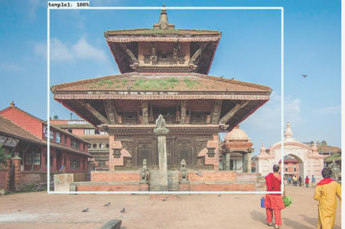
NON-FUNCTIONAL REQUIREMENT
Reliability
Performance
Usability
Speed
5
6

Slide 8
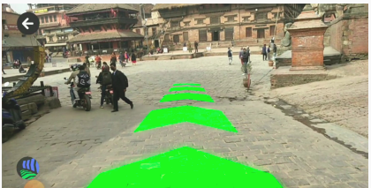





SOFTWARE REQUIREMENT
5
7

Slide 9
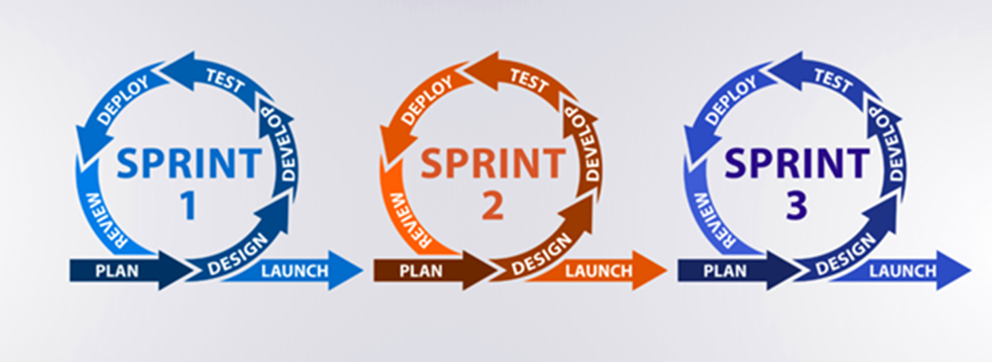
Method of Software Development
Software Development Life Cycle: Scrum under Agile
8
5

Slide 10
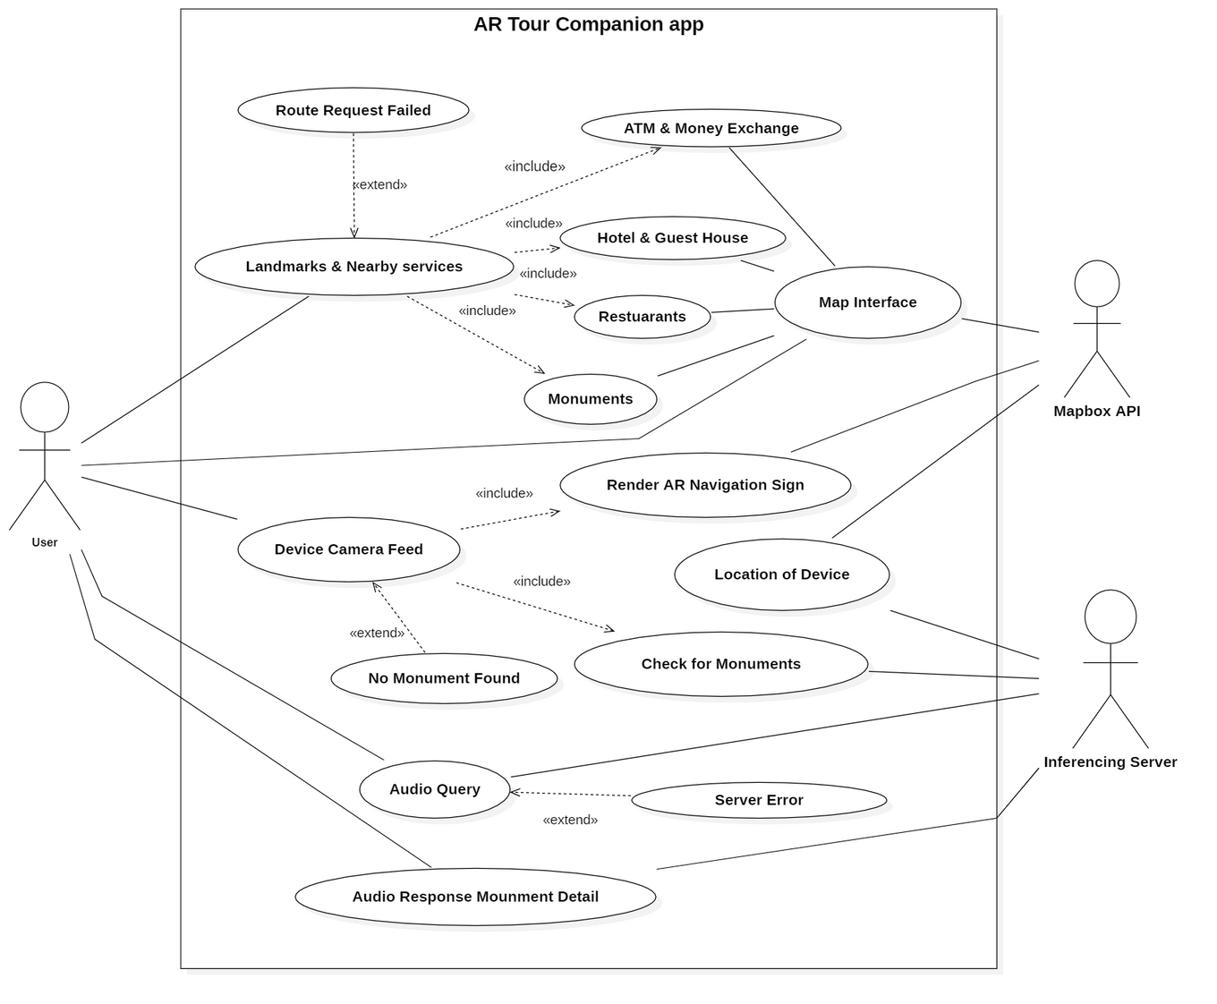
USECASE DIAGRAM
9

Slide 11
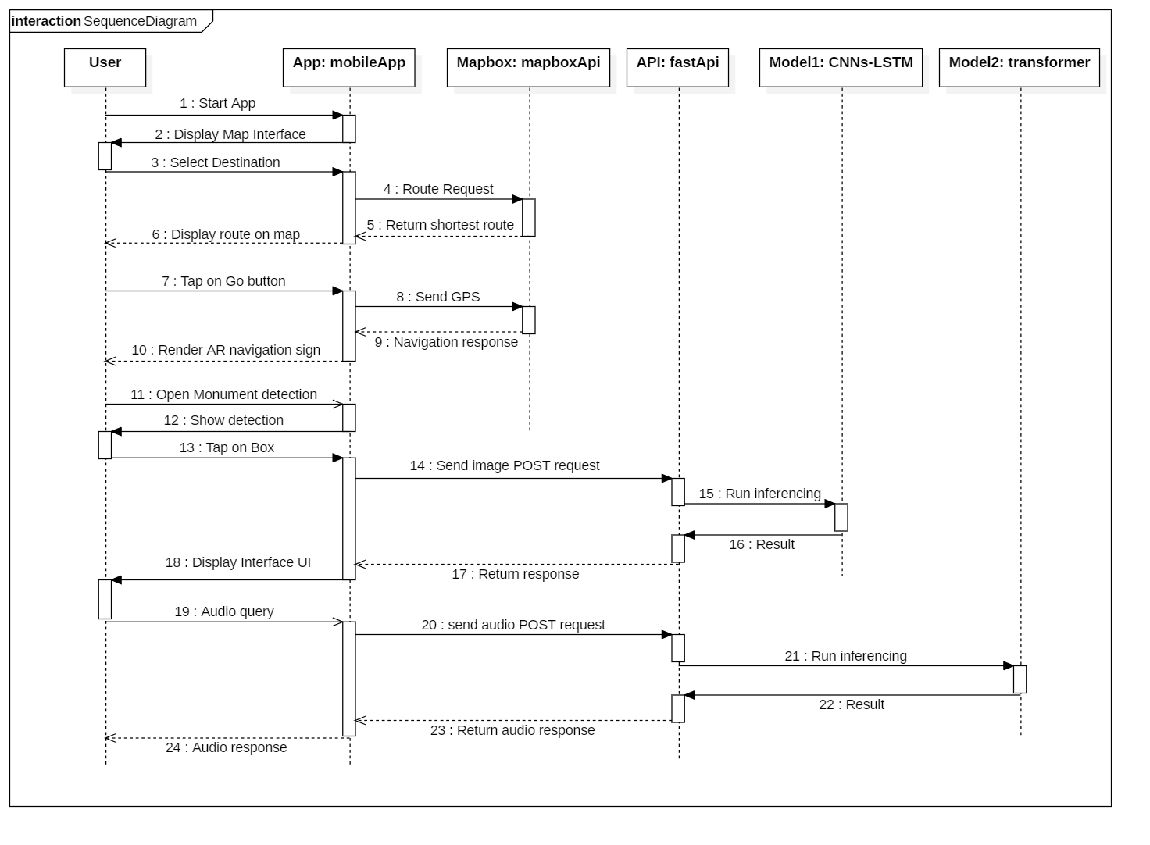
Sequence Diagram
10

Slide 12
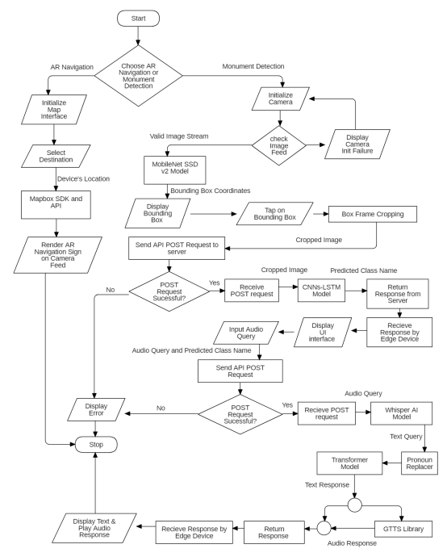
FLOWCHART DIAGRAM
11

Slide 13
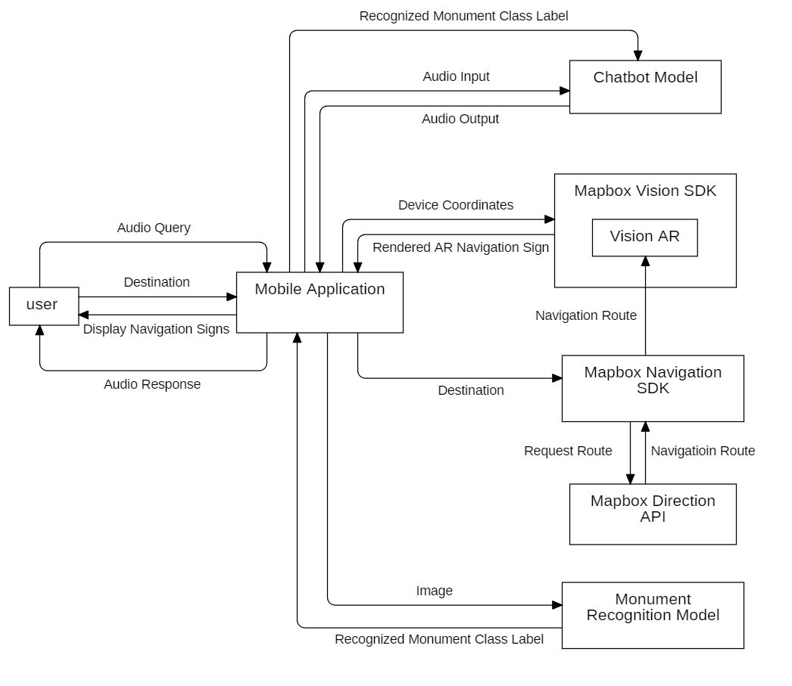
SYSTEM BLOCK DIAGRAM
12

Slide 14
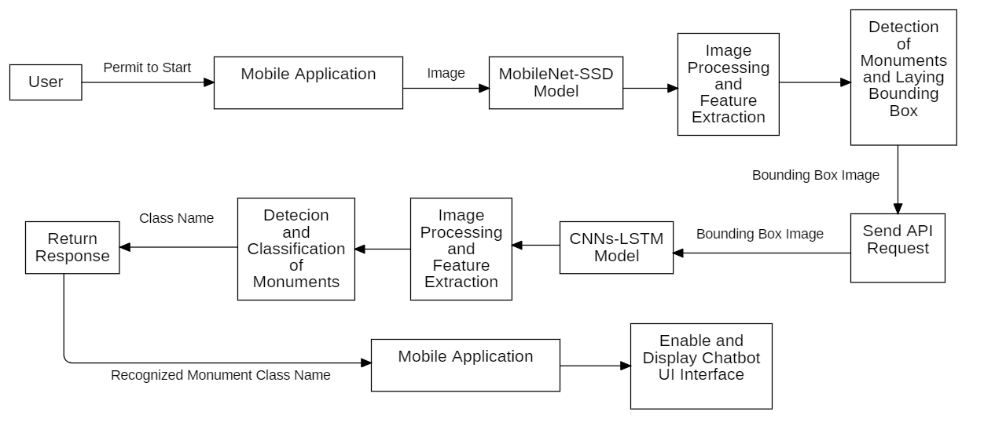
MONUMENT RECOGNITION BLOCK DIAGRAM
13

Slide 15
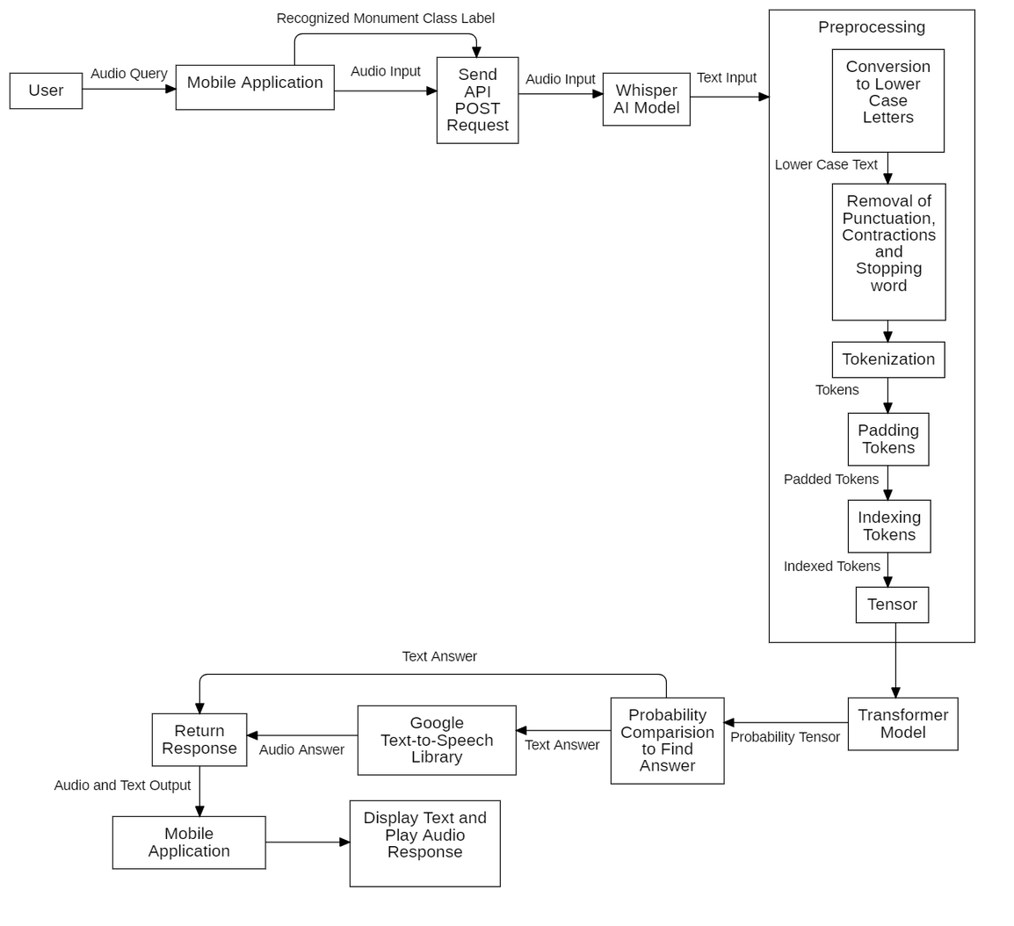
ChatBot Model BLOCK DIAGRAM
14

Slide 16
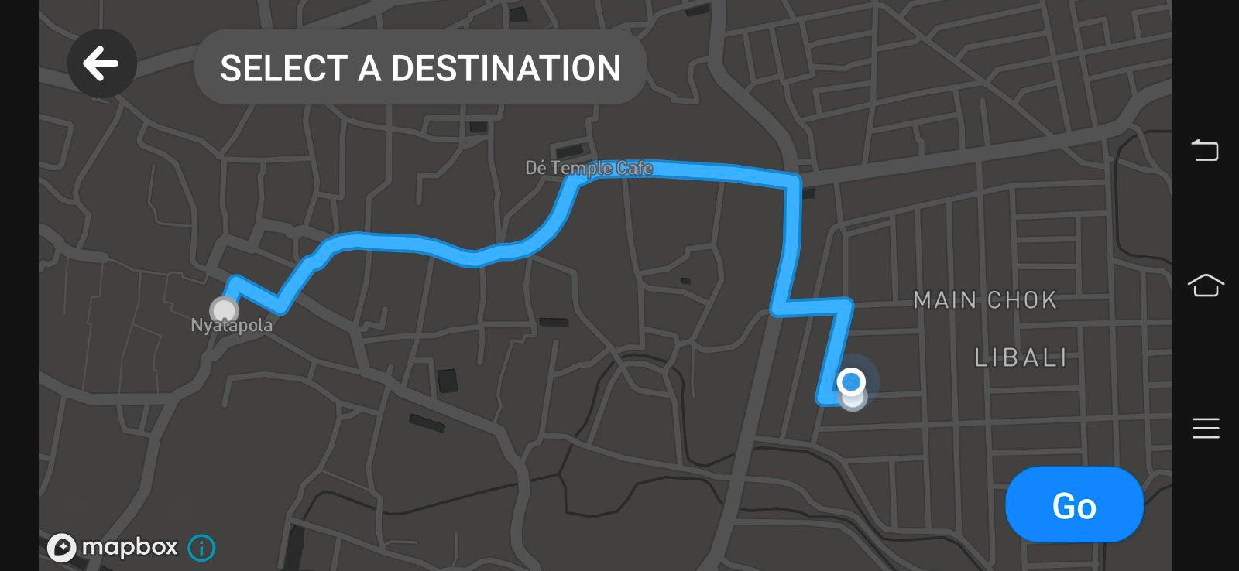
Mapbox Direction Api
It calculates routes between multiple map points.
Commonly used in navigation and route planning apps.
Offers turn-by-turn directions and travel times.
Helps with distance calculations.
15

Slide 17
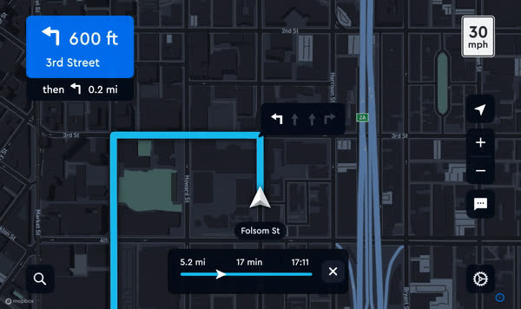
Mapbox Navigation SDK
Embeds the power of Mapbox Directions API
Provides accurate positioning on Map
Display real-time progress
provides custom map style
Handles unreliable GPS ( Dead Reckoning Algorithm )
16

Slide 18
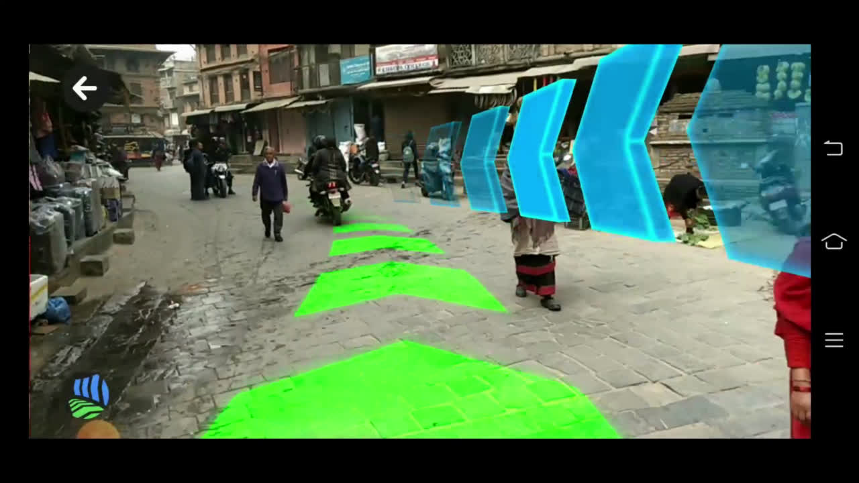
Mapbox Vision SDK
Neural Networks to Understand road in real-time
Frameworks:
Vision
Primary library
Enable Camera Configuration
Vision AR
AR framework for creating custom AR experiences
uses Mapbox Directions API and Navigation SDK
17

Slide 19
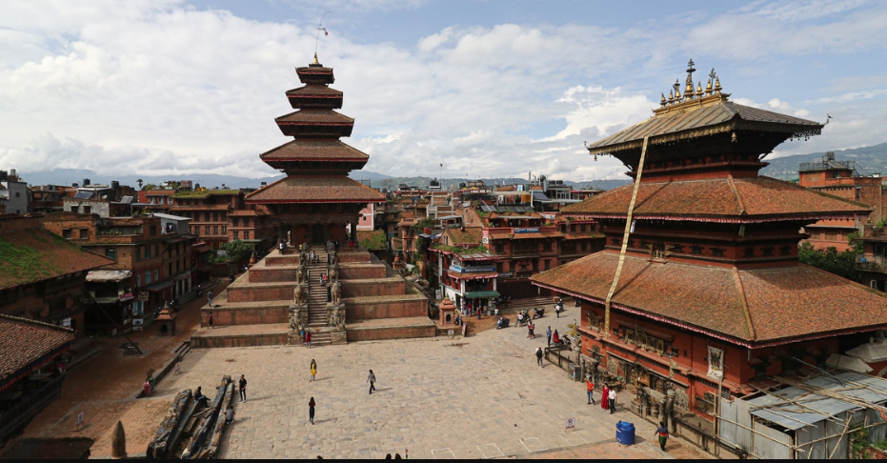
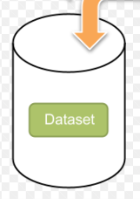
DATASET COLLECTION
Books.
Local Experts.
Online Research ( News Portals, Blogs, Article, Travel Guides).
Official Sources (Page of Bhaktapur Municipality).
Site Visit.
Web Scrapping.
18

Slide 20
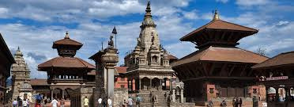
Image data set accumulation for MobilenetSSd-v2 and CNN-LSTM
Monument | Training | Testing
Bhairavnath | 179 | 43
Gopinath | 168 | 44
Nyatapola | 179 | 43
Vatsala Devi | 179 | 43
19

Slide 21
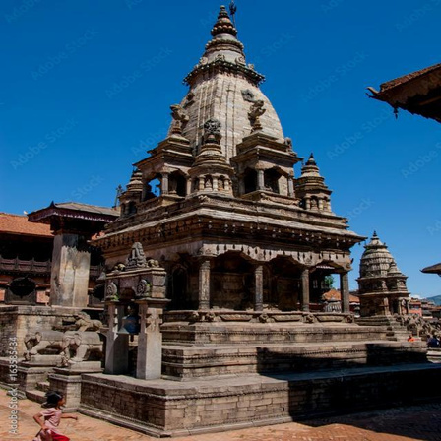
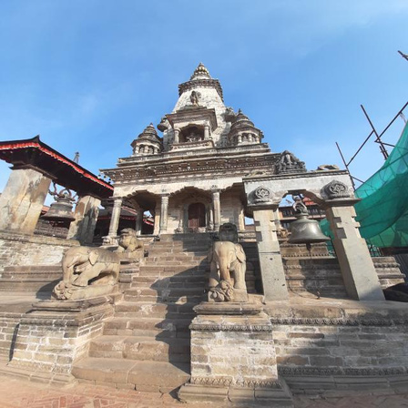
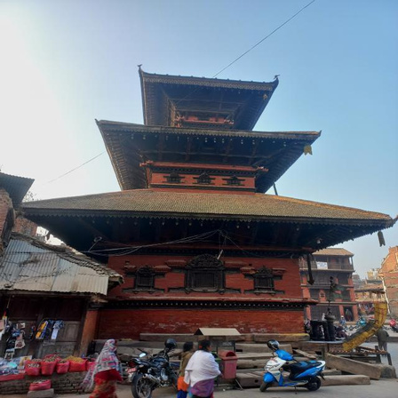
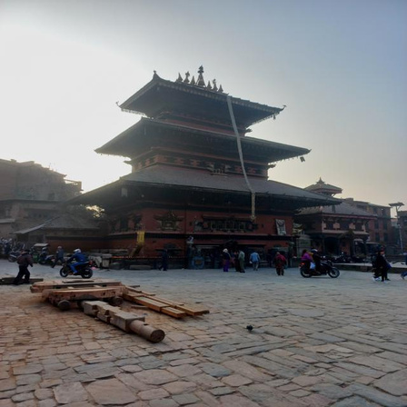
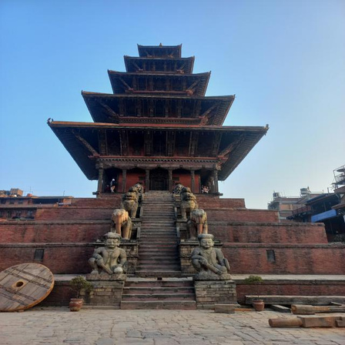
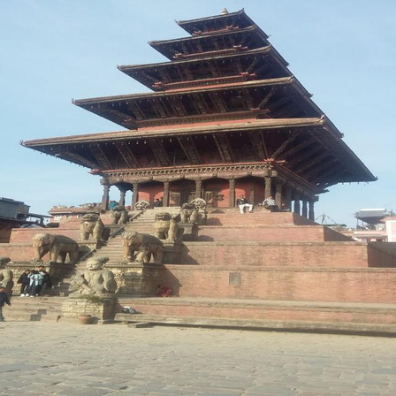
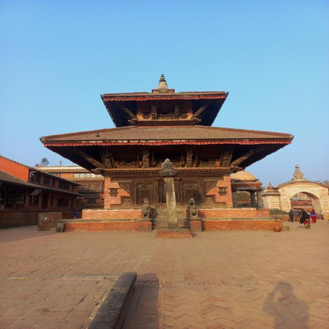
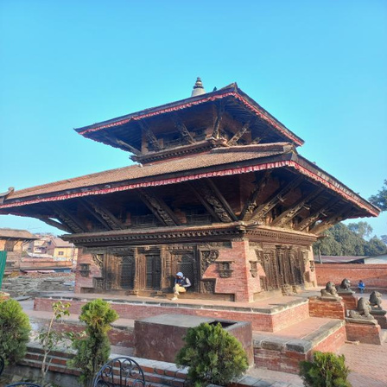
Dataset Samples for Image Classification
Vatsaladevi
Bhairavnath
Nyatapola
Gopinath
20

Slide 22
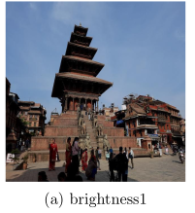
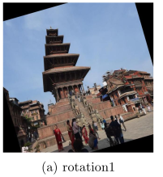
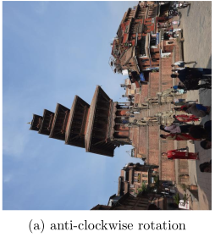
Image data set augmentation for MobilenetSSd-v2 and CNN-LSTM
Monument | Training | Testing
Bhairavnath | 1503 | 45
Gopinath | 1534 | 45
Nyatapola | 1497 | 45
Vatsala Devi | 1364 | 45
21

Slide 23
Question-Answer data set accumulation for Transformer
We collected about 5335 sets of unique question answer about different monuments around Bhaktapur Durbar Square.
Dataset after Data Augmentation
After applying data augmentation technique like Synonym replacement, Back translation we were able to expand our dataset from 5335 to 16173 sets.
22

Slide 24


DATASET PRE-PROCESSING
1. Anonymization.
2. Removing URLs.
3. Question-Answer Generation.
4. Data Structuring.
5. Data Splitting.
6. Text Cleaning.
7. Tokenization.
8. Building Vocabulary.
9. Creating DataLoader
23

Slide 25
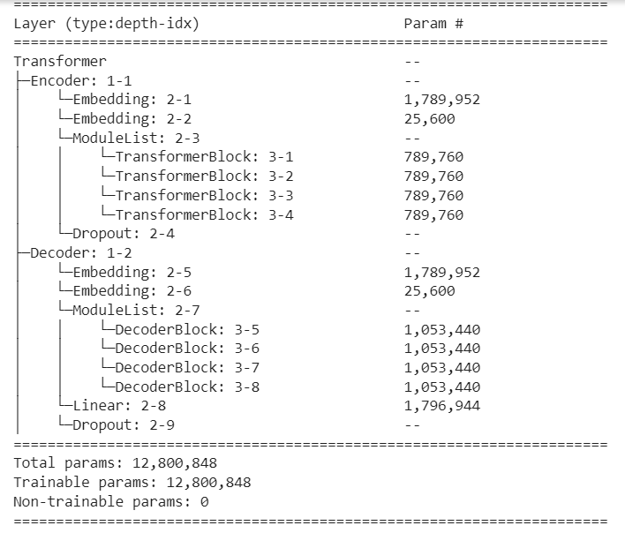

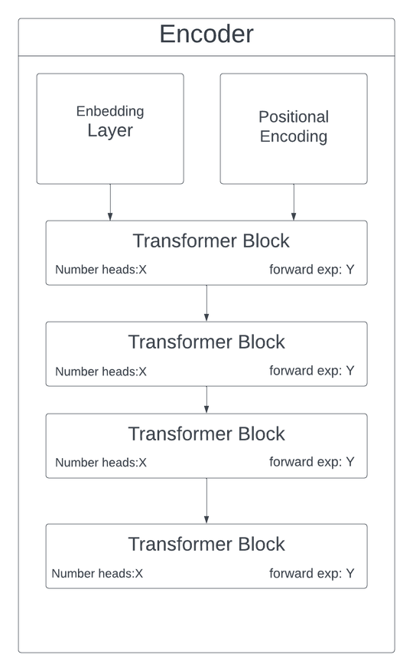
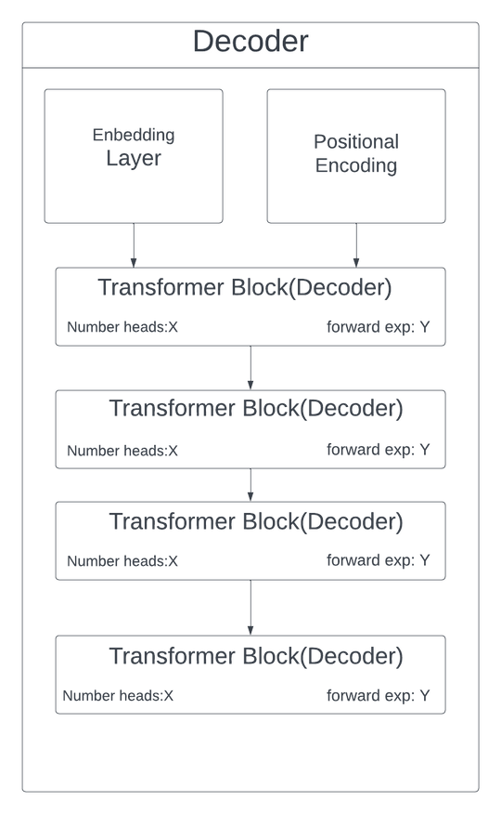
Transformer-based Neural Network
24

Slide 26

25

Slide 27
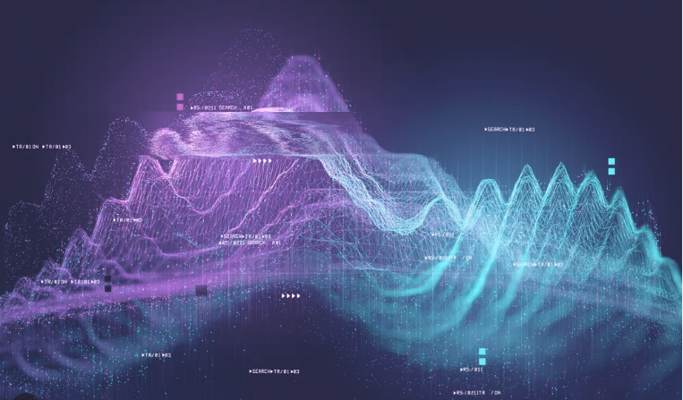
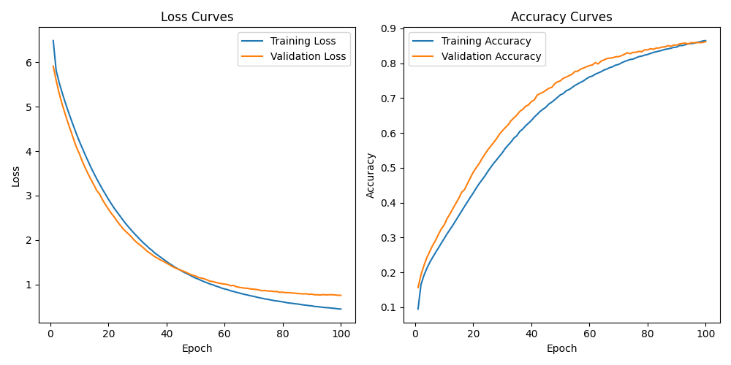
Transformer-based Neural Network Evaluation
26
figure_A: Training curves

Slide 28
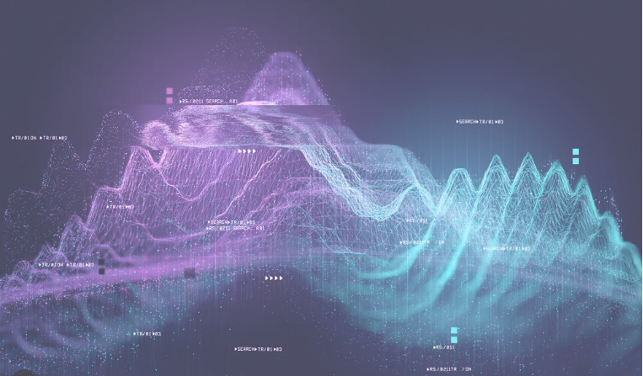
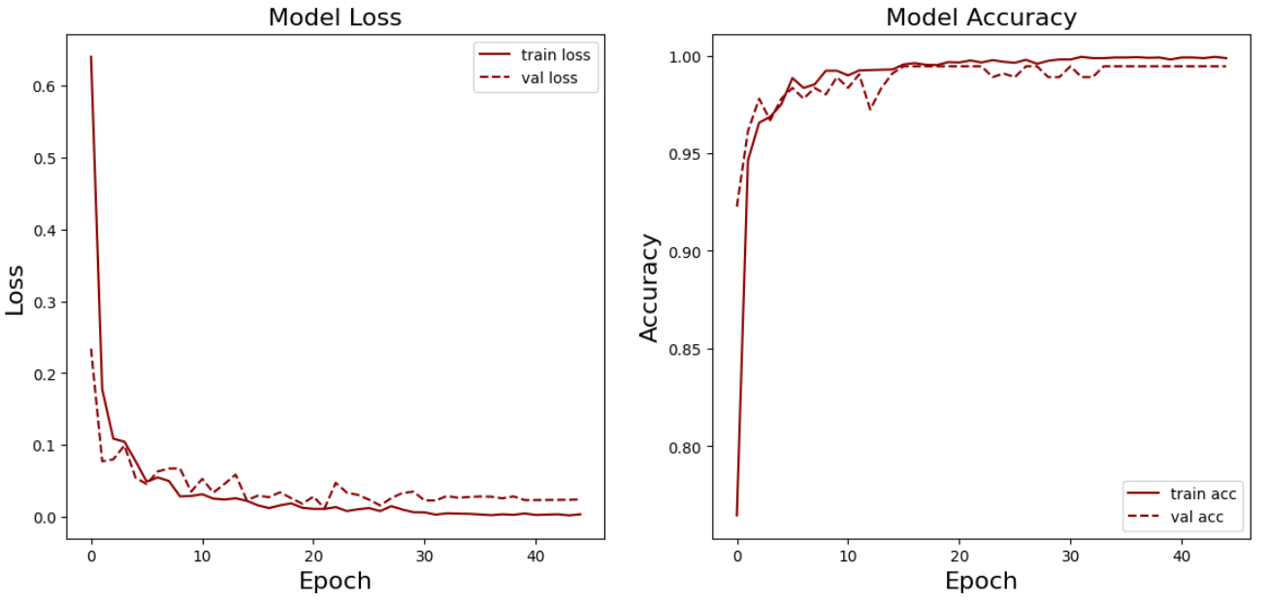
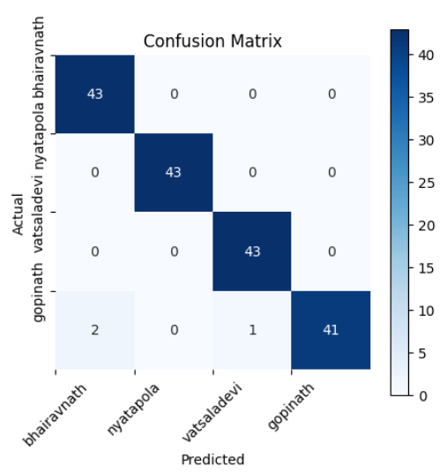
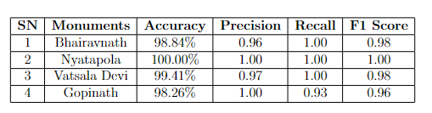
CNN-LSTM Neural Network Evaluation
figure_A: Training curves
figure_B: Confusion Matrix
27
figure_C: Evaluation Result

Slide 29
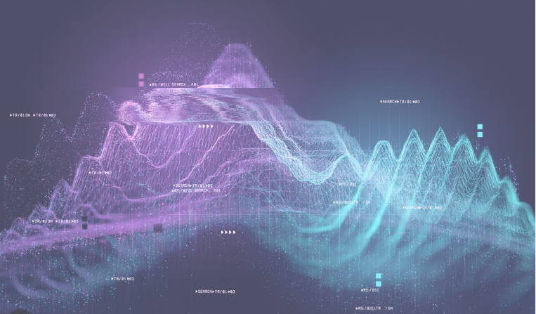
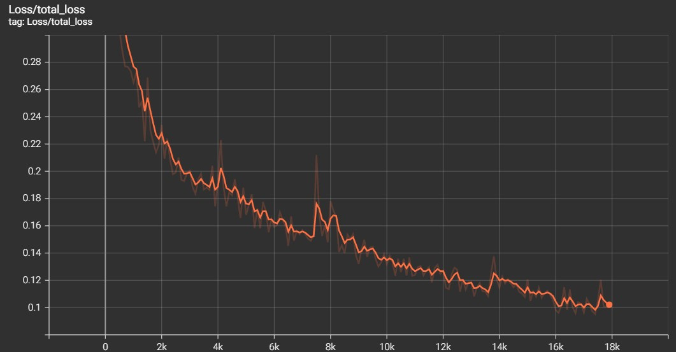
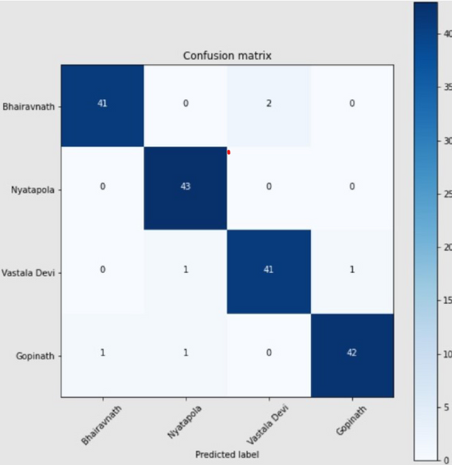
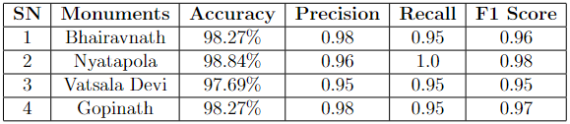
MobilenetSSd-v2 Evaluation
figure_A: Training curves
figure_B: Confusion Matrix
28
figure_C: Evaluation Result

Slide 30
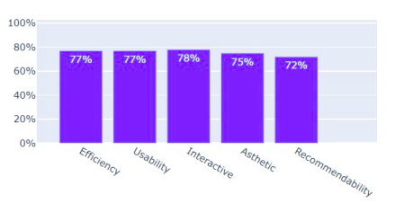
AR Navigation Evaluation
Figure(A): MOS evaluation of User Experience on AR Navigation
29

Slide 31
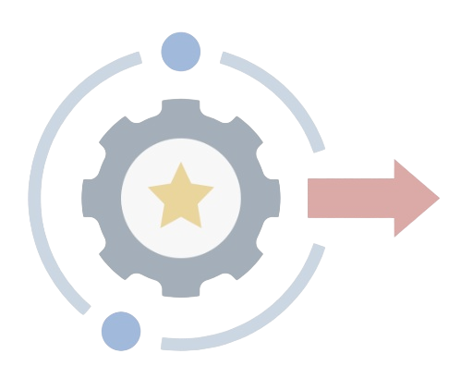
OUTPUT
30

Slide 32

Transformer-based Neural Network Output
31

Slide 33




Mobile Application Output
32

Slide 34




33

Slide 35







DEMO!
34

Slide 36
Any Questions ?
35

Slide 37
THANK YOU
36

